Slide 1


Team 24: Pyro Sensor
Bi-Weekly Update 3 Alfonso Wong
Martin Ford
Oscar Hernandez Sponsor: Rhett Guthrie TA: Niloofar Borzooei
Notes:
Michelle

Slide 2
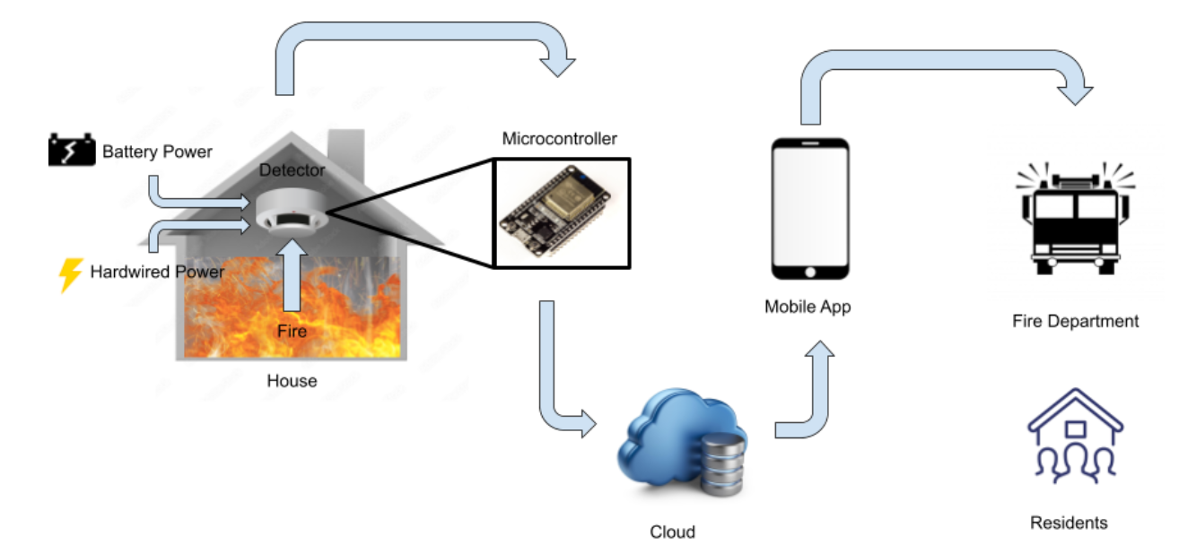
Project Summary
Problem statement:
Modern smoke detectors do not directly notify the emergency responders
Fire department has limited data of residents in buildings
Our Pyro Sensor will:
Notify any user and emergency responders instantly through a mobile app of any incident
Give fire department information about residents and pets
Notes:
Kyle

Slide 3
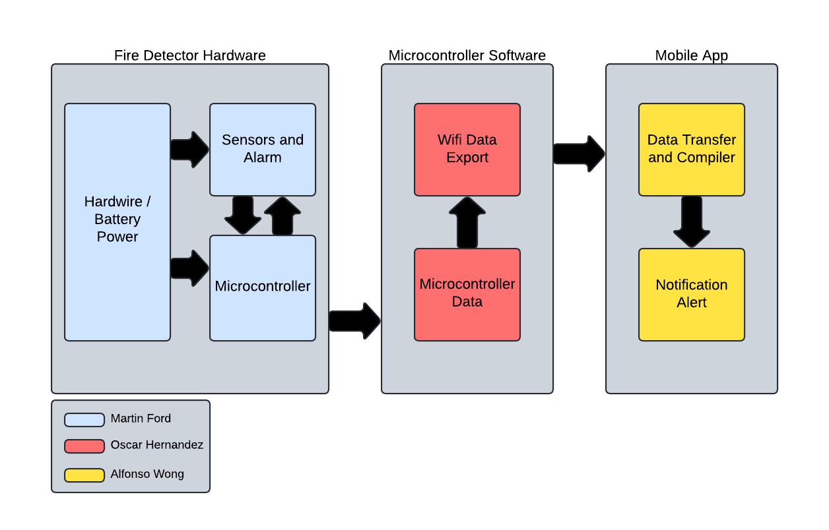
Project/Subsystem Overview
Hardware
Collects sensor data and sends it to microcontroller
MC Software
Gets sensor data, calculates it and sends it to mobile application
Mobile Application
Displays sensor information and will alert users and Fire Department (through central dispatcher) in case of fire alert.
Notes:
Eric

Slide 4
Major Project Changes for 404
Hardware
N/A
MC Software
N/A
Mobile Application
Alerting 911 central dispatcher instead of directly fire department
Notes:
i don’t think we need this slide

Slide 5
Project Timeline
 | 02/03 | 02/17 | Date
App works in customers side, can create account |  |  | 02/17
workspace, display sensor info, read/write to database |  |  | 02/17
Power is successfully delivered to full PCB |  |  | 02/17
Some sensors work and deliver signals |  |  | 02/17
MCU code establishes connection with app’s subsystem database, and sends sensor data to it. |  |  | 02/17
Fix PCB schematic mistakes |  |  | 02/17
Fix/update notification System, picture upload |  |  | 03/03
Switch communication to centralized dispatcher |  |  | 03/03
Reorder and resolder PCB |  |  | 03/03
Ensure all sensor modules are functional |  |  | 03/03
Final MCU-app integration |  |  | 03/03
PCB-MCU integration |  |  | 03/03
Notes:
Eric

Slide 6
Hardware Subsystem
Martin Ford
Accomplishments since last update 21 hrs of effort | Ongoing progress/problems and plans until the next presentation
Fix schematic errors Order new PCB and parts | Resolder PCB Validate PCB

Slide 7
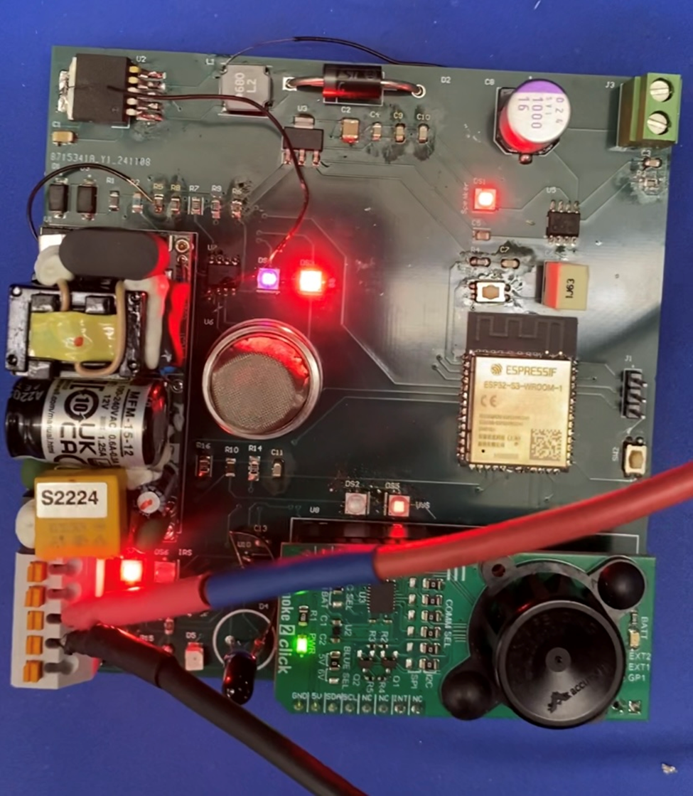
Hardware Subsystem
Martin Ford
What works:
Power distribution to full PCB
Speaker makes sound from signal
Sensor modules deliver signal to microcontroller
What does not work:
Speaker sound needs greater amplification

Slide 8
Microcontroller Software Subsystem
Oscar Hernandez
Accomplishments since last update 34 hrs of effort | Ongoing progress/problems and plans until the next presentation
Completed integration of MCU with app’s Firebase GUI. Added reset functionality. Updated alarm component from speaker to active buzzer as per PCB redesign. | Update constants and global variables from hardware calibration results.

Slide 9
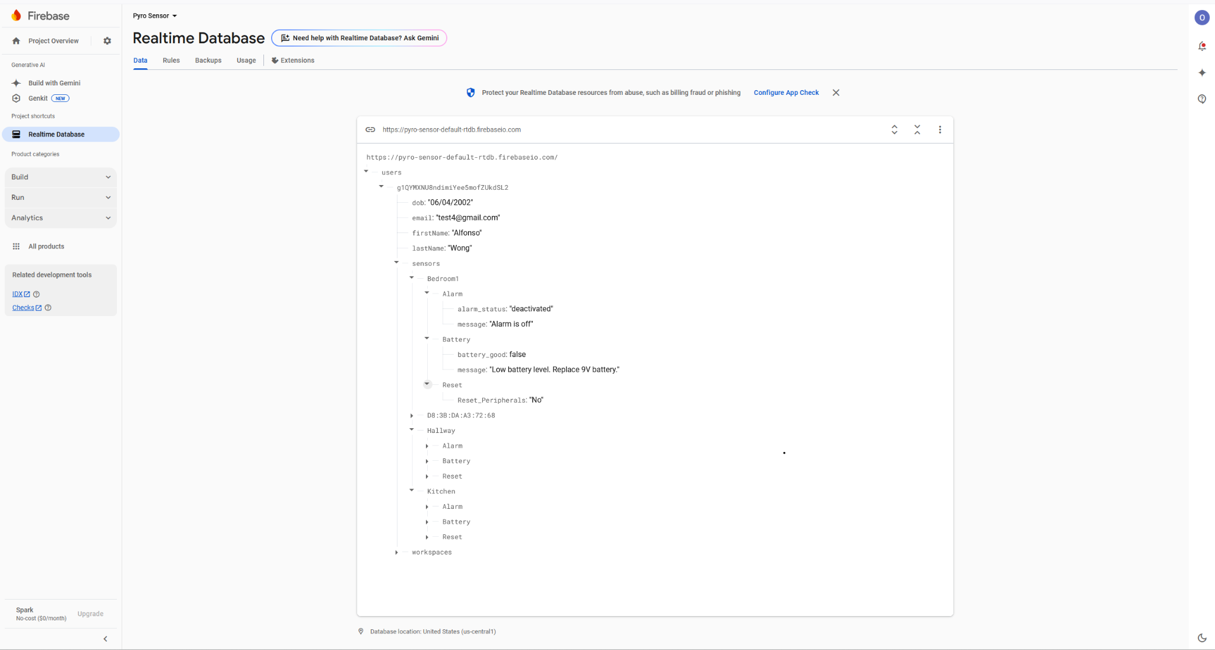
Microcontroller Software Subsystem
Oscar Hernandez

Slide 10
Mobile Application Subsystem
Alfonso Wong
Accomplishments since last update 40 hrs of effort | Ongoing progress/problems and plans until the next presentation
The mobile application is back up and running and able to pull data from the database (Firebase) MCU can access mobile app database UI feature for adding device to app finished Pictures can know be uploaded App creates access code during workspace creation Firefighter’s sign in page Alert text message to central dispatcher(Twilio API) | Fixing in-app view for firefighters Fire tracking feature with real-time data provided by MCU

Slide 11
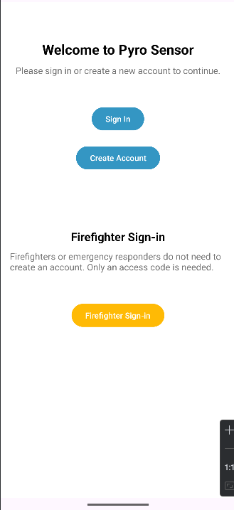
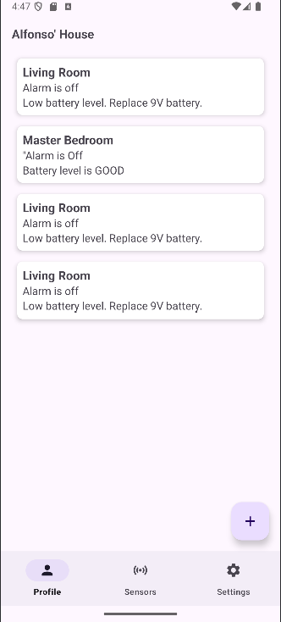
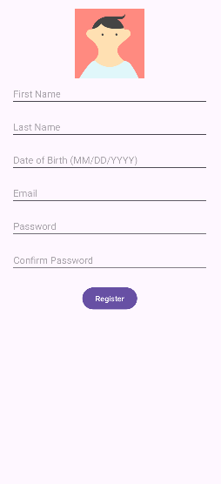
Mobile Application Subsystem
Alfonso Wong

Slide 12
Hardware-MCU Integration
Martin Ford and Oscar Hernandez
Accomplishments since last update 12 hrs of effort | Ongoing progress/problems and plans until the next presentation
Flash ESP32 with code Read sensor signals Read battery power level Deliver speaker alarm signal | Signal calibration
Notes:
could be merged to subsystem slides

Slide 13
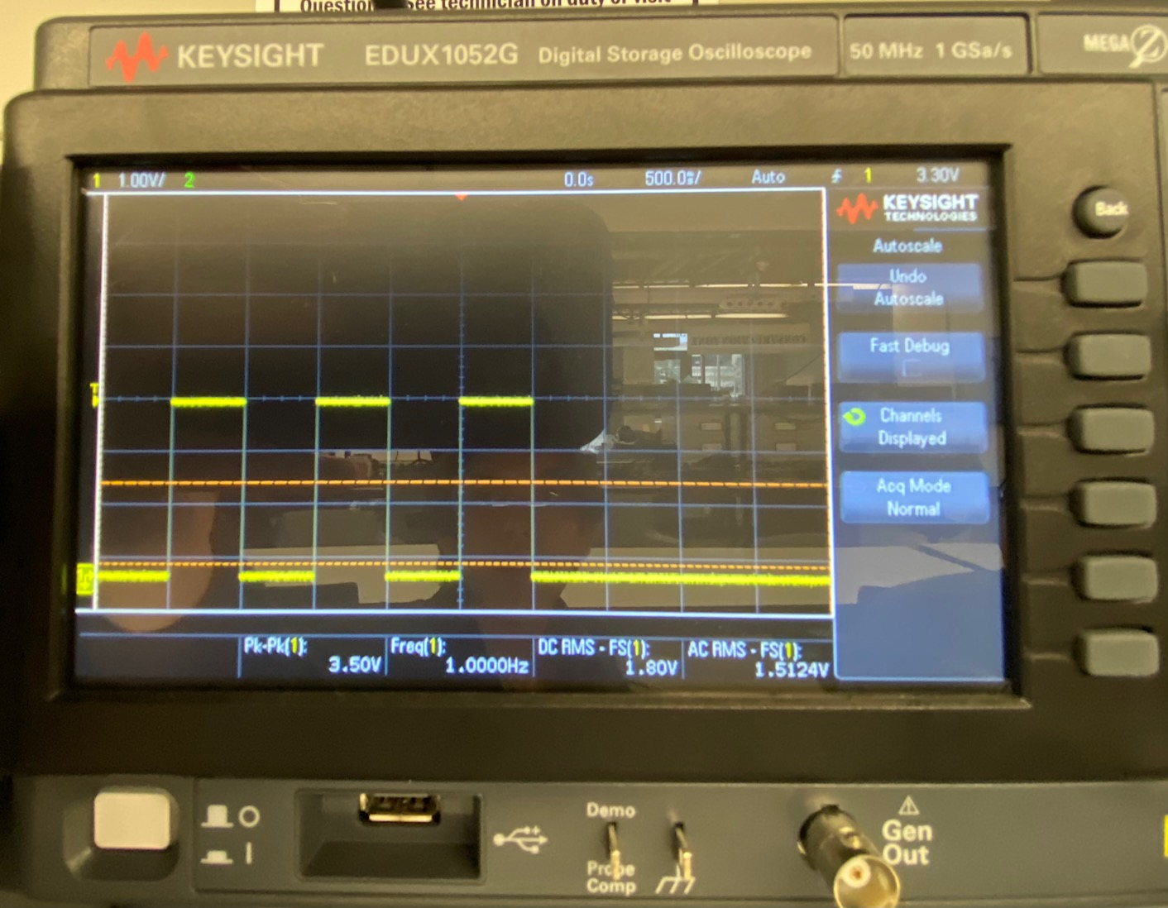
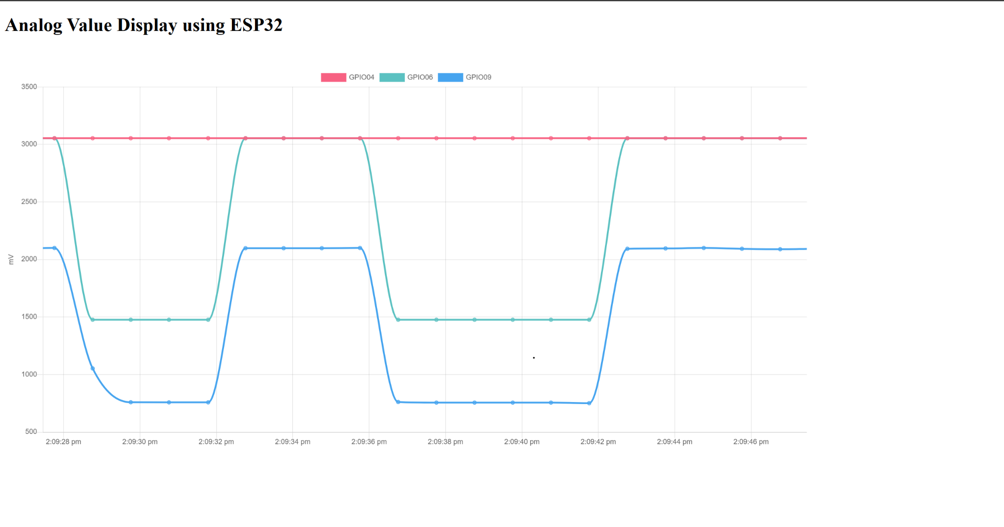
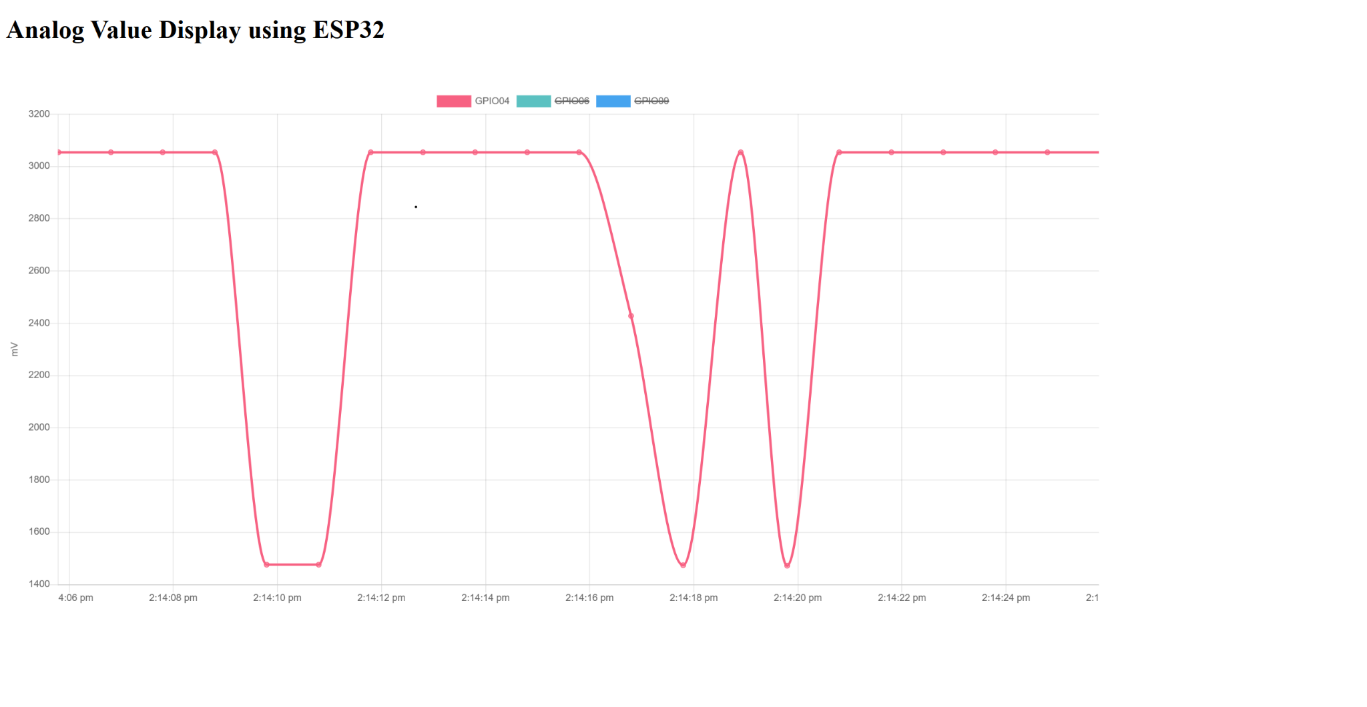
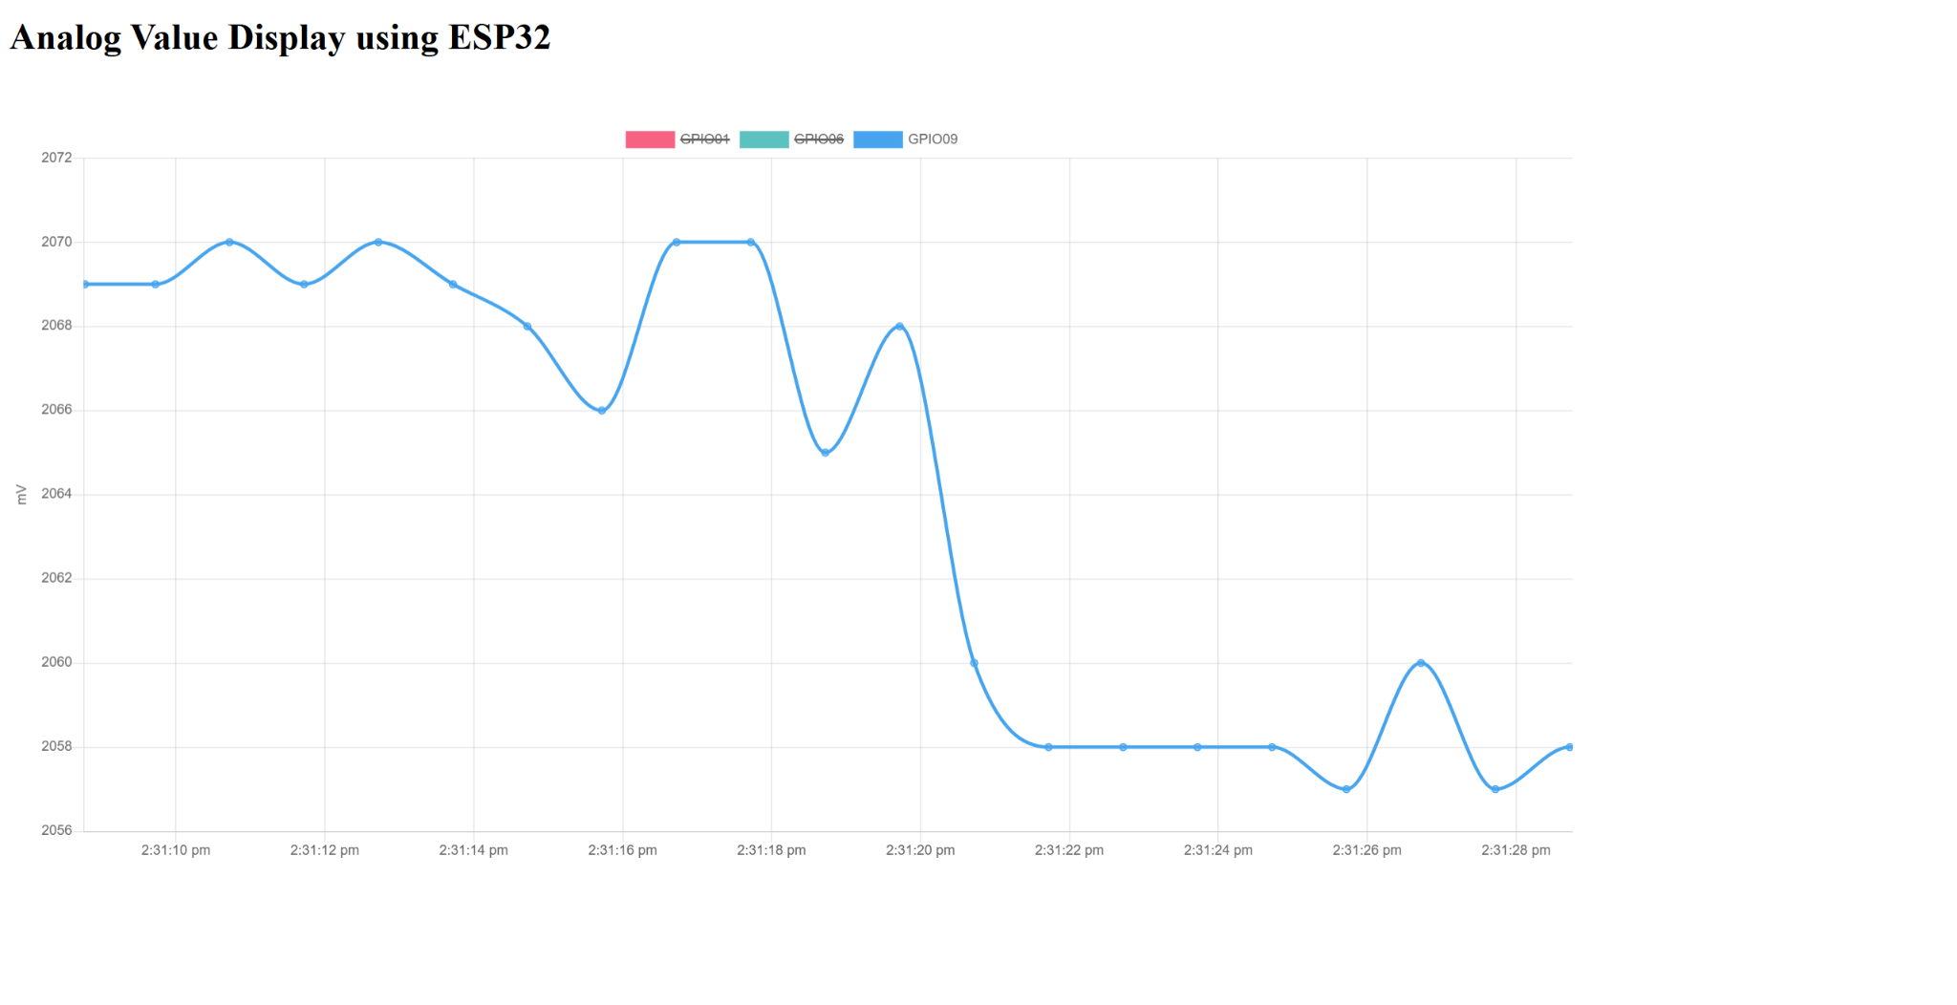
Hardware-MCU Integration
Martin Ford and Oscar Hernandez
What works:
MCU reads sensor signals
MCU reads battery power level
MCU sends speaker alarm signal
What does not work:
Signal readings need to be calibrated further
IR and UV sensor signals readings are linked but should be individual
Speaker alarm signal
IR & UV signals
Gas sensor signal
Battery power (test 9V dropped to 7V)
Notes:
could be merged to subsystem slides

Slide 14
MCU-App Integration
Oscar Hernandez and Alfonso Wong
Accomplishments since last update 12 hrs of effort | Ongoing progress/problems and plans until the next presentation
MCU can access user’s sensor data and write to it App can pull real-time data from database written by MCU. MCU can reset itself as per app request. | Contact between MCU and mobile app using bluetooth Provide information from mobile app to MCU during bluetooth connection
Notes:
could be merged to subsystem slides

Slide 15
Parts Ordering Status
Hardware Subsystem Parts Status
New PCB and parts are ordered and on the way
Microcontroller and Network Subsystem Parts Status
Order additional MCUs to simulate network nodes (rooms) as needed.
Mobile Application Subsystem
If needed, I will pay for the subscription to APIs. (~$2/month)
Notes:
don’t think we need this slide

Slide 16
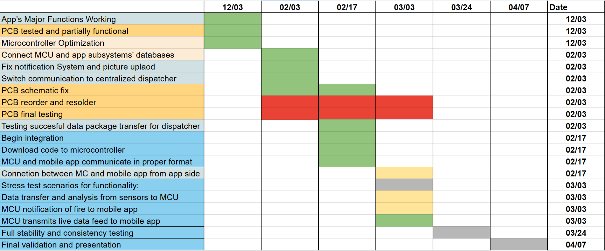
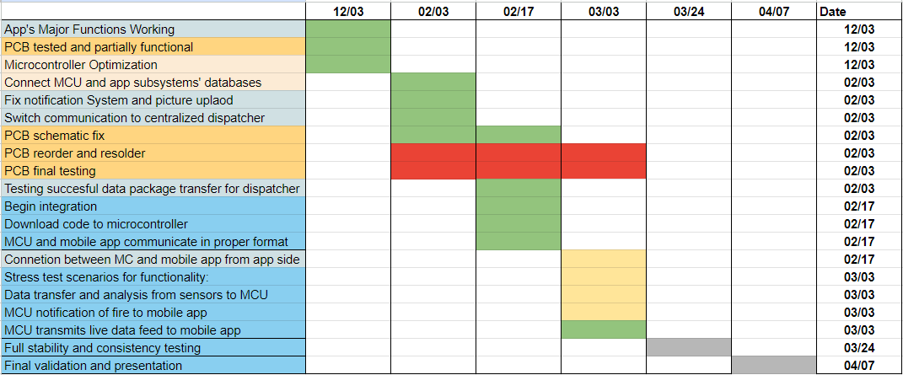
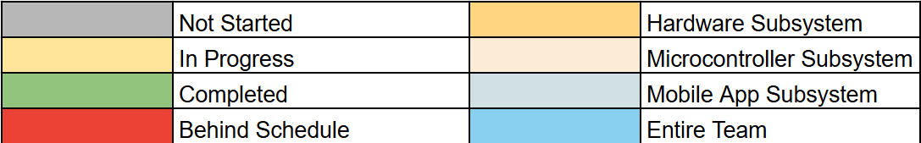
Execution & Plan
Notes:
Michelle

Slide 17
Validation Plan
Paragraph # | Test Name | Success Criteria | Status | Responsible Engineers
3.2.1.1 | Sensor Functionality | Sensors detect smoke/flame at expected ranges and output a signal. | Untested | Martin Ford
3.2.2.6 | Speaker Functionality | Speaker emits sound from signal at >65 dB. | Untested | Martin Ford
3.2.2.5 | Operating Time | System operates and receives full power continuously for 1 hour on each power source. | Untested | Martin Ford
3.2.1.4 | Network | MCU is able to aggregate data from sensors to a Access Point. | Tested | Oscar Hernandez
3.2.1.14 | Trouble Signal | MCU sends trouble signal to app for malfunctions. | Tested | Oscar Hernandez
3.2.1.8 | User Profile Creation | User is able to create an account and be able to sign in. | Tested | Alfonso Wong
3.2.1.9 | Push Notifications | Be able to push notifications to users and send text to central dispatcher. | Tested | Alfonso Wong
3.2.1.10 | Design UI | Have a working UI and test with emulator. | Tested | Alfonso Wong
3.2.1.11 | Integrate Cloud Service | Mobile app has ability to pull data from cloud service and display it. | Tested | Alfonso Wong

Slide 18
Validation Plan
Paragraph # | Test Name | Success Criteria | Status | Responsible Engineers
3.2.1.6 | App compatible on Android devices | App can be used on most Android devices | Tested | Alfonso Wong
3.2.1.1 | MCU Peripherals Interface | MCU reads signals from all sensors, and activates/deactivates alarm. | Untested | Martin Ford & Oscar Hernandez
3.2.1.12 | Device and Application Communication | Device(sensor) can be added to user profile in application. | Untested | Alfonso Wong & Oscar Hernandez
3.2.2.13 | Real Time Communication | MC is feeding constant information to database and it is being displayed in real time in mobile application. | Tested | Alfonso Wong & Oscar Hernandez
3.2.1.9 | Trigger Warning from MC | MC must send a tigger alert of ongoing event and application must send notification to user and dispatch | Untested | Alfonso Wong & Oscar Hernandez
3.2.1.5 | Early Fire Detection | The system reduces the propagation of a fire by minimizing false alarms and notifying the user or fire department as soon as a fire is detected. | Untested | All

Slide 19
Thank you for your attention!
Questions?

